Slide 1
ISTA 331
Naïve Bayes, Confusion Matrices, and Review of Classes in Python
Spring 2020

Slide 2
Naïve Bayes

Slide 3
What is Naïve Bayes?
A type of probabilistic machine learning algorithm that uses a form of Bayes’ Theorem to classify instances
It is probabilistic because it uses Bayes’ Theorem, which utilizes conditional probability
It is a classification algorithm because it assigns instances a label based on the output of the Naive Bayes calculation
Does this make it supervised or unsupervised machine learning?
Naïve Bayes is common in text classification and sometimes used in medical diagnoses, though less common
Notes:
Mention train vs test sets -> the purpose of each (they will need to know for the exercise!)

Slide 4
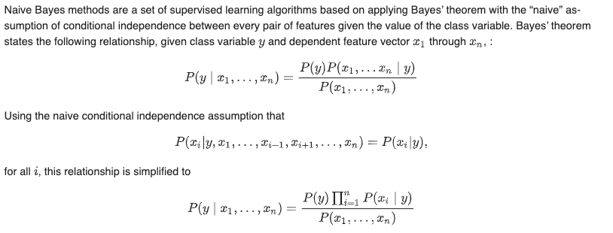
From scikit-learn:
Notes:
The math here is, well, not fun to explain. I would say it’s important to have this here because this is LITERALLY the formula, but just mention that this is not necessary to memorize and we will work with a much simpler example
First equation is just bayes theorem, but with multiple variables
Second equation says that since we will assume each feature is conditionally independent from another (each feature is independent from every other feature given the class value)
Third equation is the same as the first but just saying that you can represent conditional independence as the product of each individual feature given the class value

Slide 5
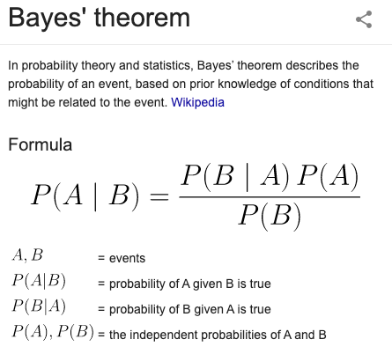
Bayes’ Theorem Overview
Notes:
Straight from google

Slide 6
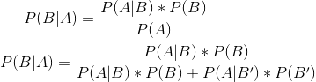
Alternate Formula for Bayes’ Theorem
The first formula is Bayes’ Theorem for B given A. The second one is an expansion of the denominator, which allows us to realize the final denominator is simply the numerator * the probabilities of its complement(s)
B’ is the complement of B, or everything but B
Most of the time, you are either given/told how to find several of the necessary values in the problem description/context
Notes:
B’ is NOT B or the complement of B

Slide 7
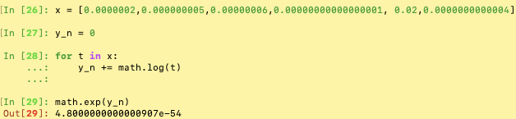
Avoiding Underflow
Since Naïve Bayes uses conditional probabilities to classify instances, it will often run into situations where really small numbers are being multiplied to each other
This leads to answers very close to 0, which can trigger underflow
To get around underflow*, when coming up with the probabilities to compute with Bayes Theorem, instead simply sum the log of all the probabilities, then take the exponential to get the final probability
* Though underflow is unlikely in the lab scenario, this way of computing the ending probability will work in scenarios where there are more data or smaller probabilities to compute. If you want more clarification, feel free to come to office hours :-)
Notes:
Gross math links: https://stats.stackexchange.com/questions/105602/example-of-how-the-log-sum-exp-trick-works-in-naive-bayes , https://stackoverflow.com/questions/34930570/at-what-point-should-i-worry-about-underflow-in-numpy-values

Slide 8
Confusion Matrices

Slide 9
What is a Confusion Matrix?
A confusion matrix is a matrix that summarizes the results of training/observing a classification algorithm
Naïves Bayes, Logistic Regression, k-Nearest Neighbors, etc.
It is a tool to evaluate a classifier, since metrics such as accuracy, reccall, and precision can be easily measured
Since most of our cases concern usually a binary class output (spam/not spam, True/False), we will only go over 2x2 examples, but this is generalizable to nxn for n class outputs
In Python, can be imported from sklearn.metrics and takes a list of predictions and a list of the associated correct labels as the arguments

Slide 10
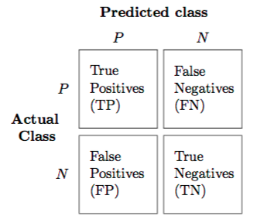
Example of a Confusion Matrix
Notice how confusion matrices only make sense when we have the “true” or “actual” outcome. Think about what each of these cells represents. For example, a False Negative (FN) is where the classifier thought the value was negative, but it is actually positive.
Notes:
Mention how positive doesn’t always literally mean positive or good; it refers to what we care about in this context regardless of the connotation
Pic link: https://www.google.com/url?sa=i&source=images&cd=&ved=2ahUKEwiTnYiWz9HkAhXIneAKHR84CDcQjRx6BAgBEAQ&url=https%3A%2F%2Fmedium.com%2Ftech-vision%2Fintroduction-to-confusion-matrix-classification-modeling-54d867169906&psig=AOvVaw3_xB1ag1cnPOmtbPdT9HUR&ust=1568595336270406

Slide 11
Key Formulas Related to Confusion Matrices
Precision
Probability that an instance is positive given the classifier thought it was positive
Also known as positive predictive value
Precison = TP/(TP + FP)
Accuracy
Probability that the classifier predicts the right or “accurate” class value
Accuracy = (TP+TN)/(TP+FP+FN+TN)
Recall
Given a positive instance, what is the probability that the classifier will predict positive
Also known as sensitivity or true positive rate
Recall = TP/(TP+FN)
Specificity
Commonly used in medical contexts
Also known as the true negative rate
Specificity = TN/(TN+FP)
False Positive Rate
False Positive Rate = FP/(FP+TN)
Notes:
The first 3 are the most important, and it is worth briefly mentioning that precision and recall have a tradeoff.

Slide 12
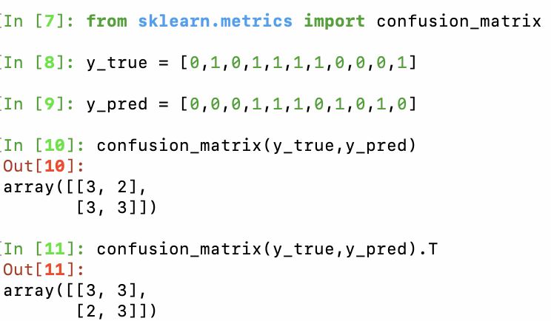
Making a Confusion Matrix with scikit-learn
sklearn’s confusion_matrix function allows us to create confusion_matrices simply by passing in the true values and the predicted values. If we want the matrix to match the format in the slides, we need to transpose the matrix.

Slide 13

In-depth Example of Classification and Confusion Matrices
Let’s say we work at a small tomato factory and we are interested in finding tomatoes we cultivate that look deformed. This is important because customers do not buy deformed tomatoes and they often go to waste. Lucky for us, we just had a machine installed that classifies tomatoes, and we want to evaluate how well the classifier is doing. So, we took 100 tomatoes and compared our evaluations to what the classifier outputted...
Notes:
Tomato pic is from https://www.google.com/url?sa=i&source=images&cd=&ved=2ahUKEwiVj5PevtHkAhVGbKwKHWXeBiAQjRx6BAgBEAQ&url=https%3A%2F%2Fwww.farmersalmanac.com%2Fcommon-tomato-plant-problems-28544&psig=AOvVaw1GdQRianwbabGGZ_mKtFZA&ust=1568590922412948

Slide 14
In-depth Example of Classification and Confusion Matrices
First, let’s call our “positive” a deformed tomato and our “negative” a non-deformed tomato.
Below is the confusion matrix:
Predicted by Machine
 | Deformed (+) | Non-Deformed (-)
Deformed (+) | 42 | 8
Non-Deformed (-) | 4 | 46
Actual Value
Questions:
If a tomato is deformed, what is the probability that the machine will output that?
How many tomatoes were incorrectly identified?
What is the probability that a tomato is deformed given the machine outputs that it is?

Slide 15
In-depth Example of Classification and Confusion Matrices
ANSWERS:
This is asking for the recall of the classifier
Recall = TP/(TP+FN) = 42/(42+8) = 21/25 = 0.84
This is asking for the number of False Positives and False Negatives
FP + FN = 8 + 4 = 12
This is asking for the precision of the classifier
Precision = TP/(TP+FP) = 42/(42+4) = 21/23 = 0.91

Slide 16
Class Review

Slide 17
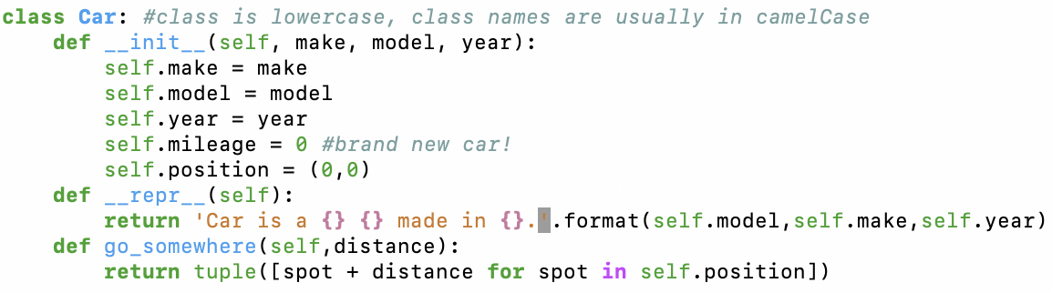
What is a Class in Python?
A Class is an object in Python that has explicitly defined behaviors/attributes that allow instances of the Class to interact with other instances of the same or different Classes
Some Common Parts of a Class:
__init__ : initializing an instance (almost always necessary)
__repr__: how to display an instance as a string
Instance methods always take self as an argument → self is an instance of the class
Functions meant to perform on instances of ( or are related to) classes are called methods
Example of a Car Class:
Notes:
All of these are instance methods.. At least go_somewhere is
Might be good to quiz them on what a static method is, they will need to use one for hw2

Slide 18
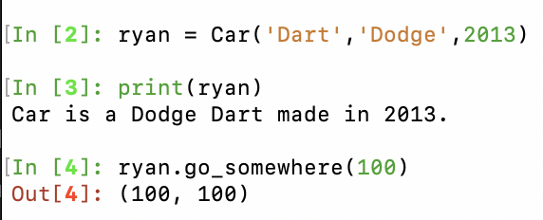
Working with Class Instances
Line 2 creates a new Car instance saved to the variable ryan
Line 3 prints the instance, which implicitly calls the __repr__ method of the Car class
Line 4 is an example of calling an instance method on an instance

Slide 19
Summary
Naïve Bayes is a type of a probabilistic classification algorithm based on Bayes’ Rule
Naïve Bayes calculations are made simpler with binary outputs, since the denominator in the original formula is greatly reduced
A confusion matrix is a matrix used to evaluate the performance of a classifier
There are numerous metrics to evaluate a classifier, including accuracy, precision, and recall
Classes in Python are objects that have explicitly defined attributes and behaviors
When making a Class, it is always important to define __init__ first, then possibly __repr__
Functions related to a Class or functions that require an instance of a Class to work are called methods

